Slide 1
PRNet: PAPR Reduction via Deep Autoencoder

Slide 2
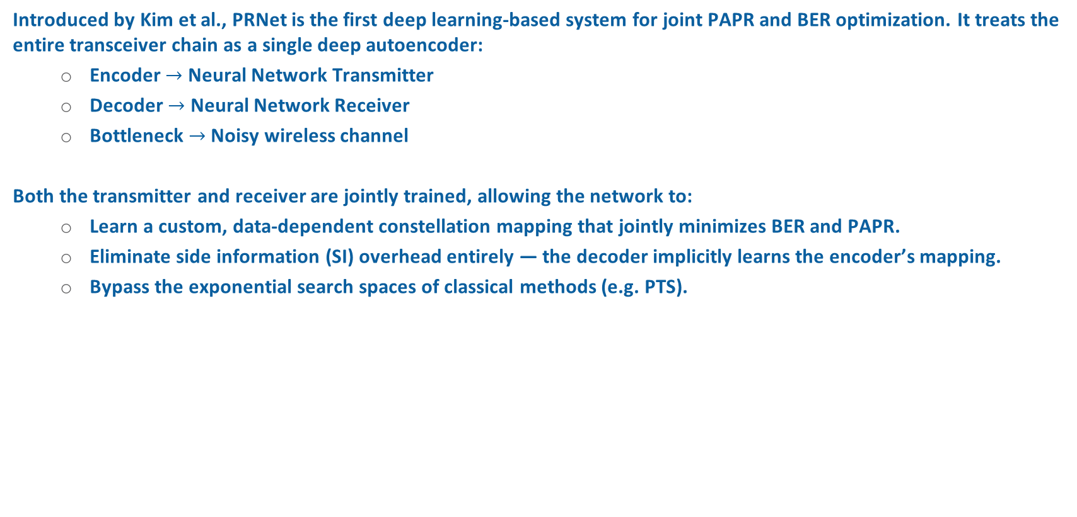
The Autoencoder Paradigm Shift
Introduced by Kim et al., PRNet is the first deep learning‐based system for joint PAPR and BER optimization. It treats the entire transceiver chain as a single deep autoencoder:
Encoder $→$ Neural Network Transmitter
Decoder $→$ Neural Network Receiver
Bottleneck $→$ Noisy wireless channel
Both the transmitter and receiver are jointly trained, allowing the network to:
Learn a custom, data‐dependent constellation mapping that jointly minimizes BER and PAPR.
Eliminate side information (SI) overhead entirely — the decoder implicitly learns the encoder’s mapping.
Bypass the exponential search spaces of classical methods (e.g. PTS).

Slide 3
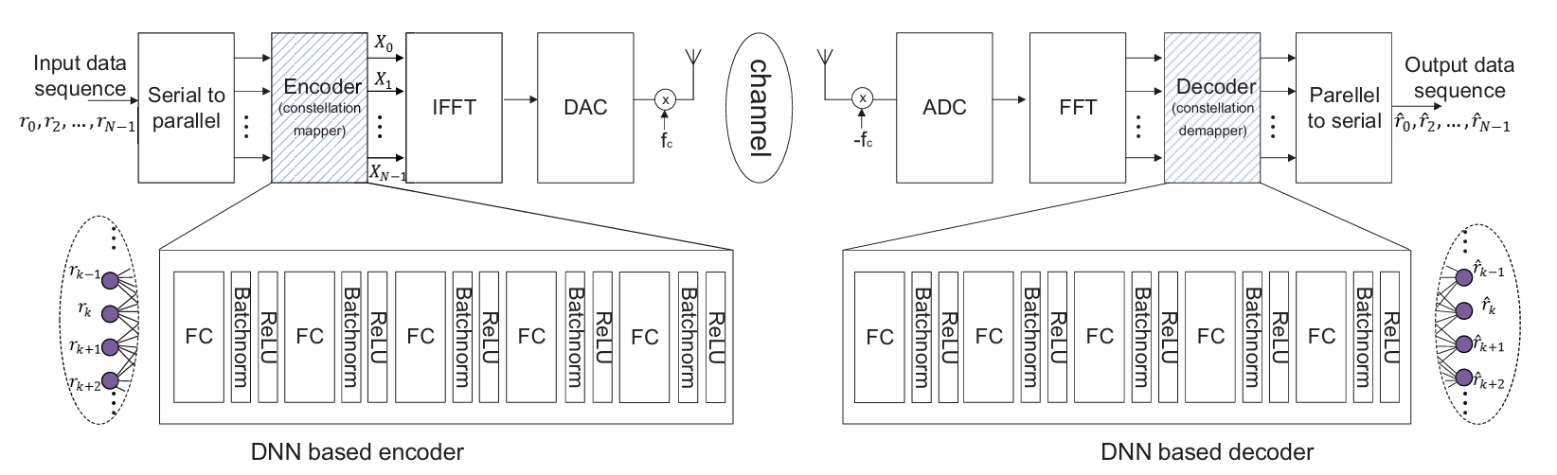
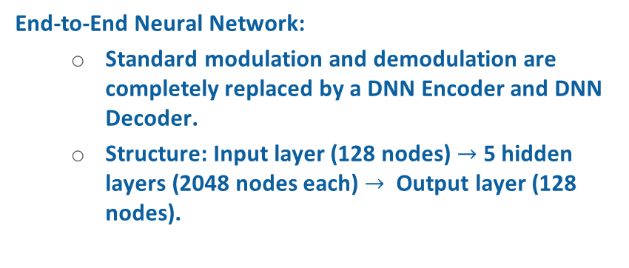
PRNet Transceiver Architecture
End-to-End Neural Network:
Standard modulation and demodulation are completely replaced by a DNN Encoder and DNN Decoder.
Structure: Input layer (128 nodes) $→$ 5 hidden layers (2048 nodes each) $→$ Output layer (128 nodes).
Inside each hidden layer block:
Fully Connected (FC): Links all data to process subcarriers jointly.
Batch Normalization (BN): Scales data to ensure stable and reliable training.
ReLU Activation: Introduces the non-linearity required to solve the highly complex trade-off between PAPR and BER

Slide 4

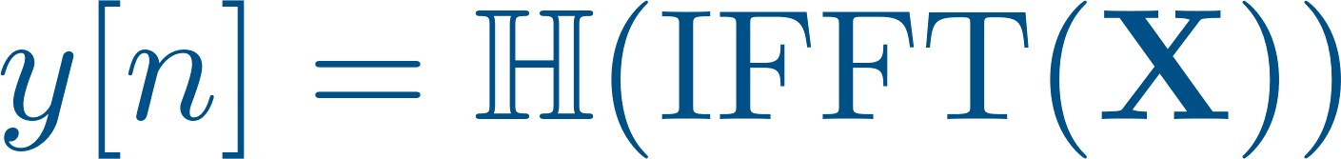
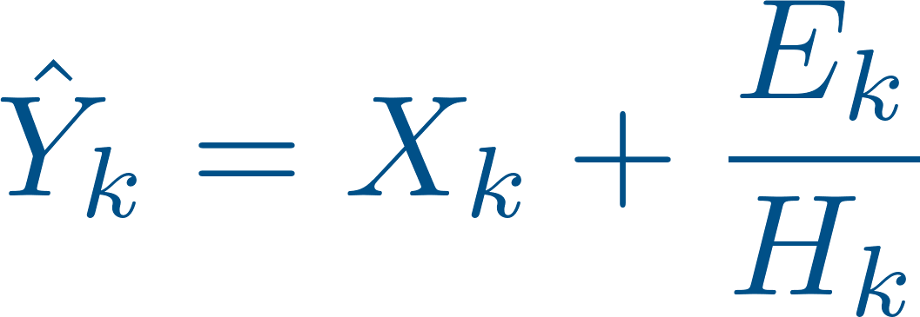
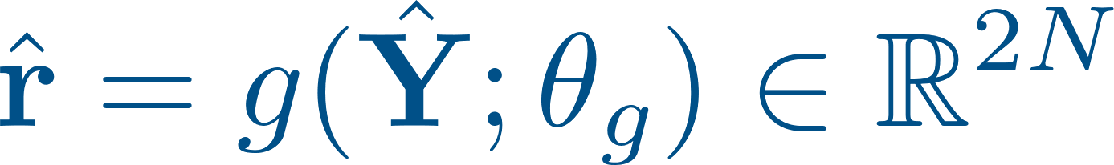
End-to-End System Model
Input Representation: Real I/Q vector
DNN Encoder: parameterized by weights
OFDM Mod & Channel: IFFT, then Rayleigh fading & AWGN
Demodulation & Equalization: FFT to frequency domain, zero-forcing
DNN Decoder: parameterized by weights
The Complete End-to-End Pipeline

Slide 5
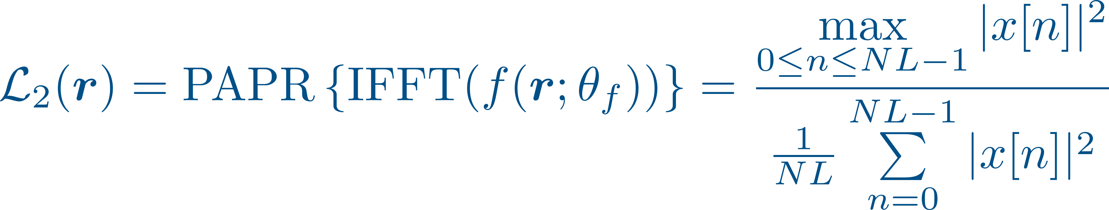

The Joint Loss Function
Reconstruction loss (MSE in${ ℝ}^{2N}$):
PAPR penalty (oversampled time‐domain waveform, $L ≥ 4$)
Joint loss: ($λ$ governs the BER–PAPR trade‐off)

Slide 6
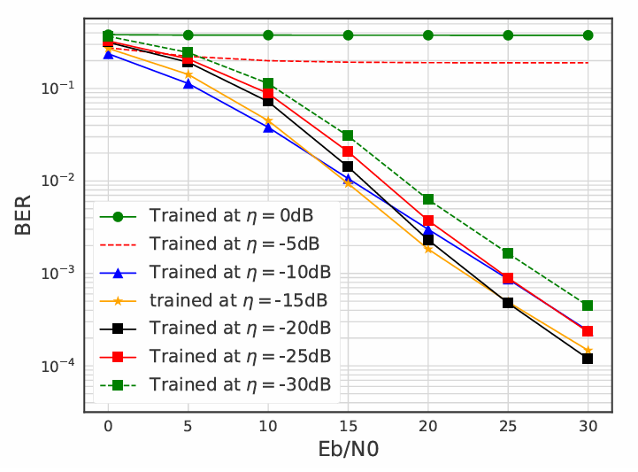
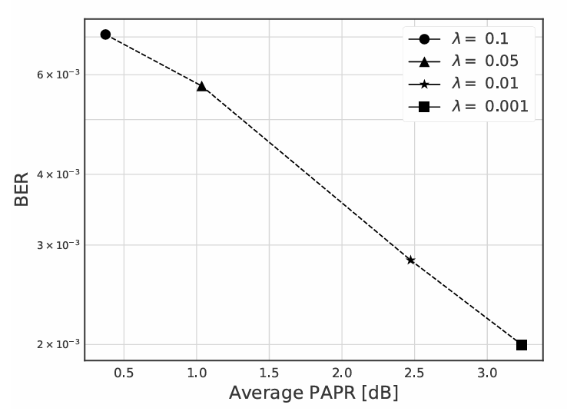


Two-Stage Training Methodology
Denoising autoencoder: Artificial noise at a corruption level $η$ (noise‐to‐signal ratio) is injected during the forward pass to simulate the physical channel and force the decoder to learn robust decision boundaries.
Stage 1 — Noise Selection ($λ$ = 0): Sweep $η$ while training with reconstruction loss $ℒ_{1}$only.
Stage 2 —Trade‐Off Training ($η = η∗$): Sweep penalty weight $λ$ under the full loss$ℒ=ℒ_{1}+ λ ℒ_{2}$

Slide 7
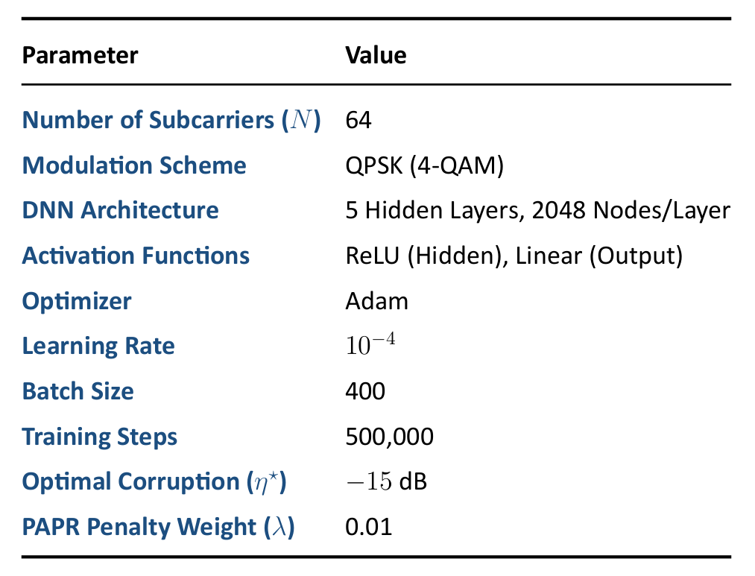
Simulation Setup & Parameters

Slide 8
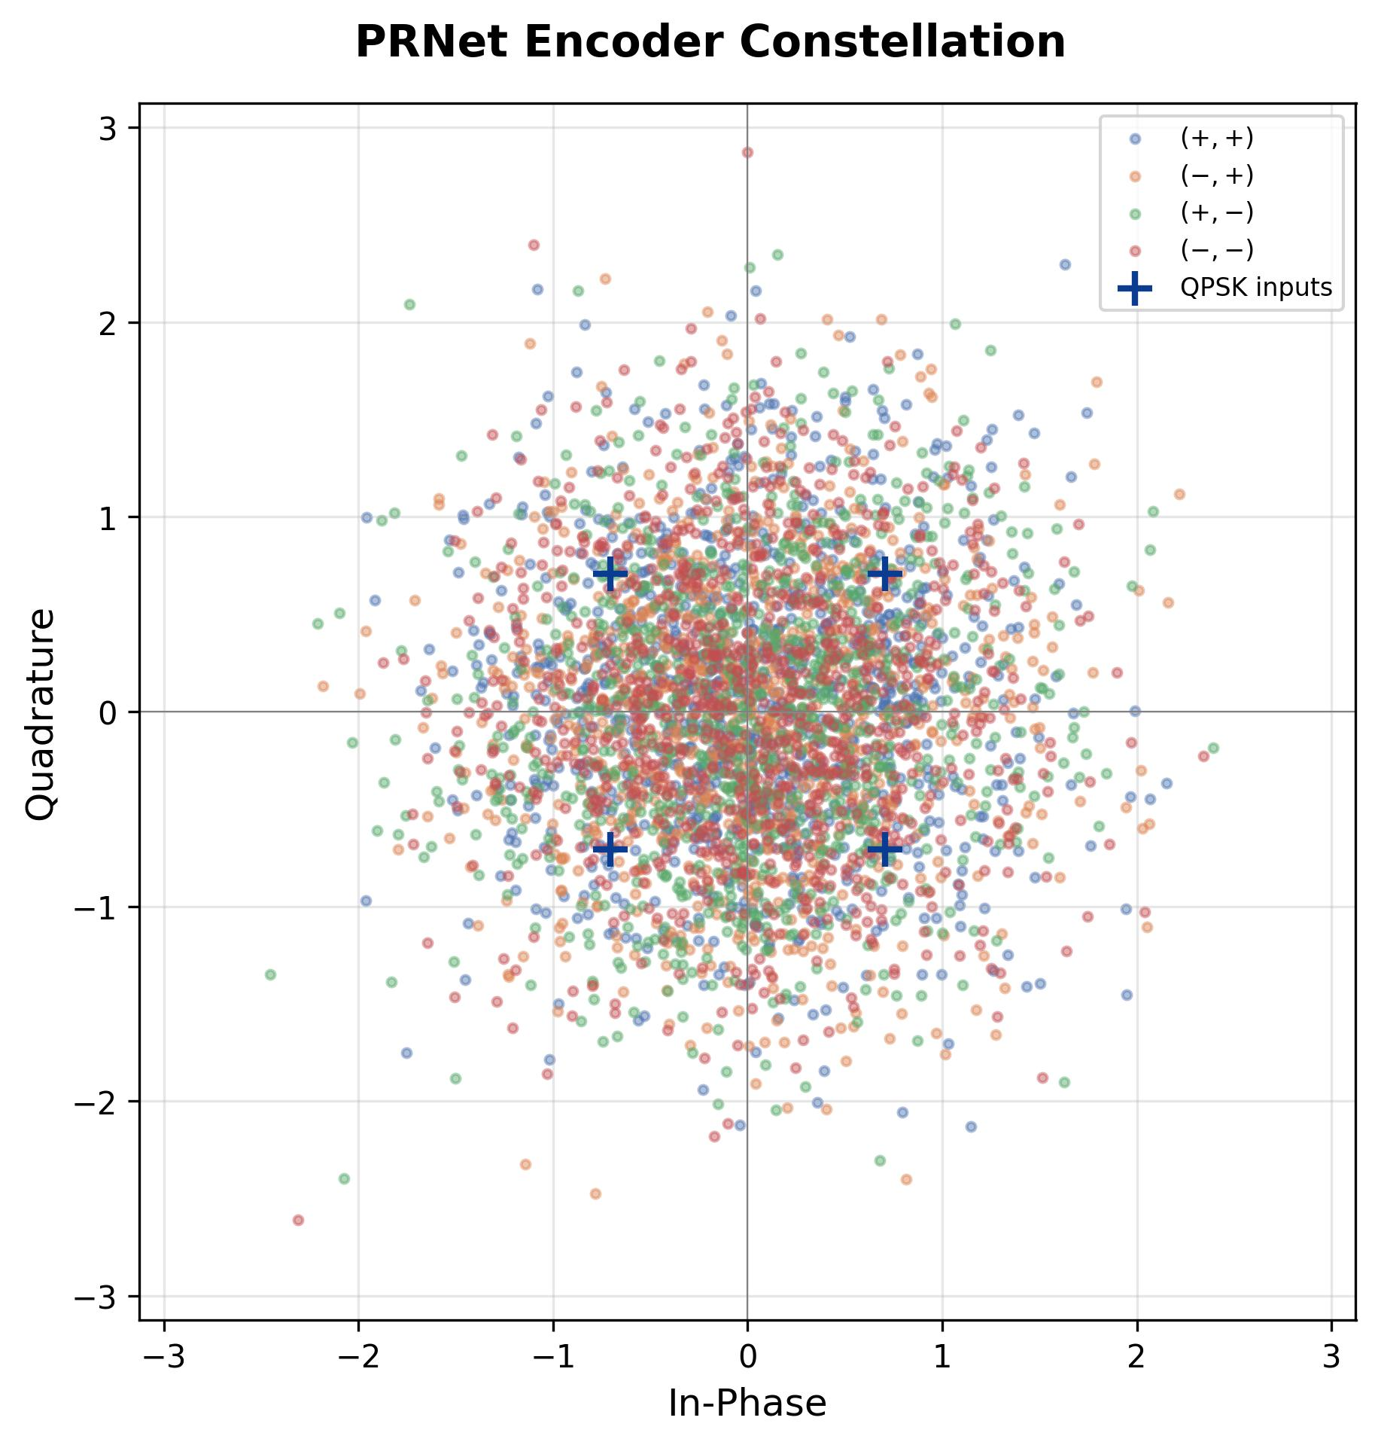
Learned Constellation Shaping
Unlike classical OFDM with rigid QPSK boundaries, the PRNet encoder dynamically disperses constellation points:
Maps discrete input data into a continuous, cloud-like spatial distribution.
Trades traditional Euclidean spacing for optimal PAPR reduction.
The jointly trained decoder learns to recover data from this custom distribution without explicit knowledge of the mapping.

Slide 9
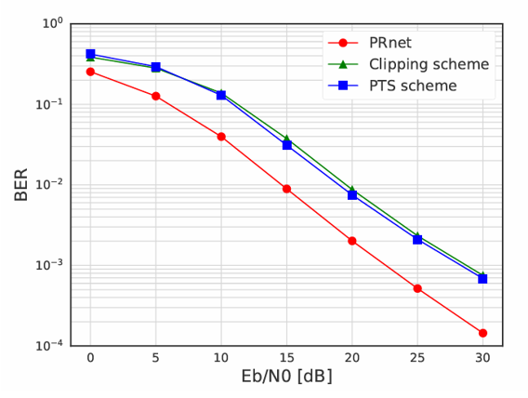
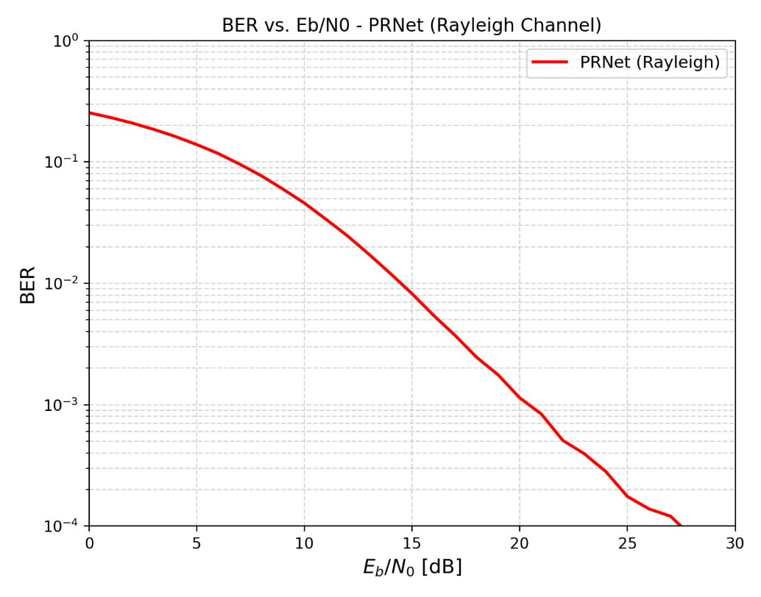
BER Performance
Original Paper
Our Reproduction
Accurate Reproduction: Our independently trained model perfectly matches the BER curve from the original paper.
Superior to Classical Methods: PRNet achieves a lower Bit Error Rate (BER) than traditional techniques like Clipping and PTS.
Proven Robustness: The results confirm that the neural network successfully learns to protect the data against severe channel fading.

Slide 10
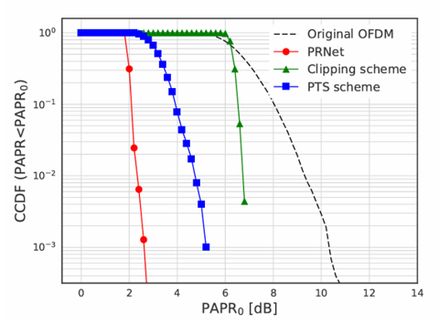
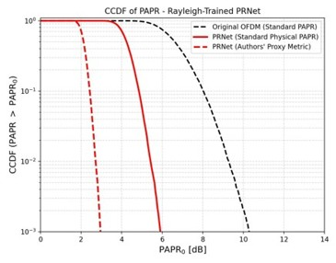
PAPR Performance
Original Paper
Our Reproduction
Massive Reduction: PRNet successfully reduces PAPR by an impressive 4–5 dB compared to standard OFDM (≈ 10.5 dB).
A Surprising Discrepancy: The original paper reports a final PAPR of ≈ 3 dB. However, our strict reproduction reveals the true physical PAPR is actually ≈ 6 dB.

Slide 11
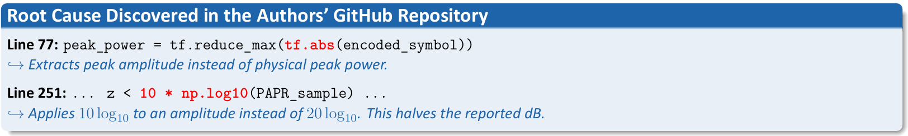
PAPR Reduction – Discrepancy Investigated
To understand why our results exactly doubled the original paper's claims, we audited the authors' open-source implementation.
The Mathematical Impact: This coding error artificially halves the reported values, making a true 6 dB PAPR look like 3 dB.
The Reality: Even after fixing this mathematical error, PRNet still reduces PAPR by an impressive 4–5 dB compared to standard OFDM.

Slide 12
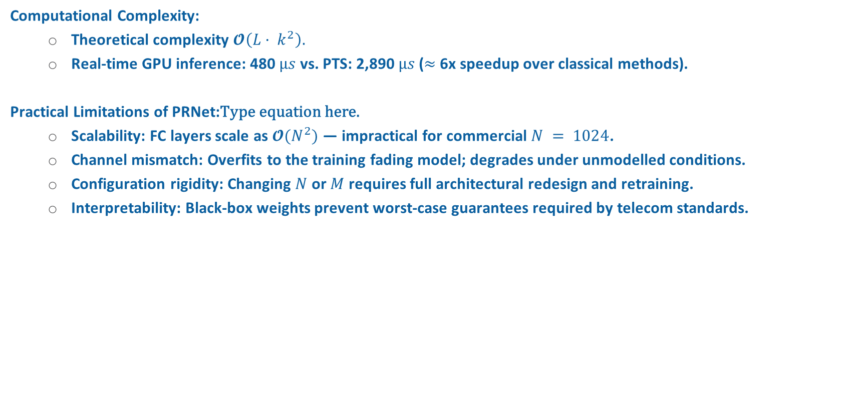
Computational Complexity & Limitations
Computational Complexity:
Theoretical complexity $𝓞\left(L· k^{2}\right).$
Real‐time GPU inference: 480 $µs$ vs. PTS: 2,890 $µs$ ($≈$ 6x speedup over classical methods).
Practical Limitations of PRNet:
Scalability: FC layers scale as $𝓞(N^{2})$— impractical for commercial $N = 1024$.
Channel mismatch: Overfits to the training fading model; degrades under unmodelled conditions.
Configuration rigidity: Changing $N$ or $M$ requires full architectural redesign and retraining.
Interpretability: Black‐box weights prevent worst‐case guarantees required by telecom standards.

